Slide 1
Design of Datapath elements in Digital Circuits
Debdeep Mukhopadhyay

Slide 2
What is datapath?
Suppose we want to design a Full Adder (FA):
  Sum=A ^ B ^ CIN = Parity(A,B,CIN)
  COUT=AB+ACIN+BCIN=MAJ(A,B,CIN)
Combine the two functions to a single FA logic cell:
ADD(A[i],B[i],CIN,S[i],COUT)
How do we build a 4-bit ripple carry adder?

Slide 3
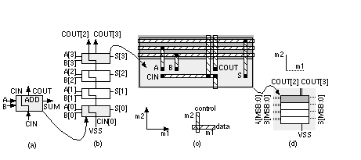
A 4 bit Adder
The layout of buswide logic that operates on data signals is called a Datapath.
The module ADD is called a Datapath element.

Slide 4
What is the difference between datapath and standard cells?
Standard Cell Based Design: Cells are placed together in rows but there is no generally no regularity to the arrangement of the cells within the rows—we let software arrange the cells and complete the interconnect.
Datapath layout automatically takes care of most of the interconnect between the cells with the following advantages:
  Regular layout produces predictable and equal delay for each bit.
  Interconnect between cells can be built into each cell.

Slide 5
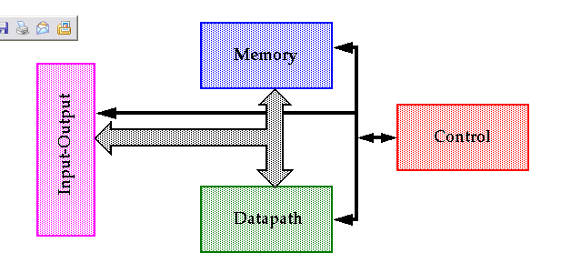
Digital Device Components
We shall concentrate first on this.

Slide 6
Why Datapaths?
The speed of these elements often dominates the overall system performance so optimization techniques are important.
However, as we will see, the task is non-trivial since there are multiple equivalent logic and circuit topologies to choose from, each with adv./disadv. in terms of speed, power and area.
Datapath elements include shifters, adders, multipliers, etc.

Slide 7
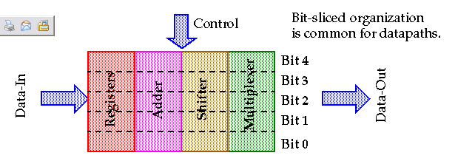
Bit slicing
How can we develop architectures
which are bit sliced?

Slide 8
Datapath Elements

Slide 9
Shifters
Sel1 | Sel0 | Operation | Function
0 0 1 1 | 0 1 0 1 | Y<-A Y<-shlA Y<-shrA Y<-0 | No shift Shift left Shift right Zero outputs
What would be a bit sliced architecture of this simple shifter?

Slide 10
Using Muxes
Con[1:0]
A[2]
MUX
Y[2]
A[1]
0
A[1]
MUX
Y[1]
A[0]
A[2]
0
A[0]
MUX
A[1]
Y[0]
0

Slide 11
Verilog Code
module shifter(Con,A,Y);
input [1:0] Con;
input[2:0] A;
output[2:0] Y;
reg [2:0] Y;
always @(A or Con)
begin
case(Con)
0: Y=A;
1: Y=A<<1;
2: Y=A>>1;
default: Y=3’b0;
endcase
end
endmodule

Slide 12
Combinational logic shifters with shiftin and shiftout
Sel | Operation | Function
0 1 2 3 | Y<=A, ShiftLeftOut=0 ShiftRightOut=0 Y<=shl(A), ShiftLeftOut=A[5] ShiftRightOut=0 Y<=shr(A), ShiftLeftOut=0 ShiftRightOut=A[0] Y<=0, ShiftLeftOut=0 ShiftRightOut=0 | No shift Shift left Shift Right Zero Outputs

Slide 13
Verilog Code
always@(Sel or A or ShiftLeftIn or ShiftRightIn);
begin
A_wide={ShiftLeftIn,A,ShiftRightIn};
case(Sel)
0: Y_wide=A_wide;
1: Y_wide=A_wide<<1;
2: Y_wide=A_wide>>1;
3:Y_wide=5’b0;
default: Y=A_wide;
endcase
ShiftLeftOut=Y_wide[0];
Y=Y_wide[2:0];
ShiftRightOut=Y_wide[4];
end

Slide 14
Combinational 6 bit Barrel Shifter
Sel | Operation | Function
0 1 2 3 4 5 | Y<=A Y<-A rol 1 Y<-A rol 2 Y<- A rol 3 Y<-A rol 4 Y<-A rol 5 | No shift Rotate once Rotate twice Rotate Thrice Rotate four times Rotate five times

Slide 15
Verilog Coding
function [2:0] rotate_left;
input [5:0] A;
input [2:0] NumberShifts;
reg [5:0] Shifting;
integer N;
begin
Shifting = A;
for(N=1;N<=NumberShifts;N=N+1)
begin
Shifting={Shifting[4:0],Shifting[5])};
end
rotate_left=Shifting;
end
endfunction

Slide 16
Verilog
always @(Rotate or A)
begin
case(Rotate)
0: Y=A;
1: Y=rotate_left(A,1);
2: Y=rotate_left(A,2);
3: Y=rotate_left(A,3);
4: Y=rotate_left(A,4);
5: Y=rotate_left(A,5);
default: Y=6’bx;
endcase
end

Slide 17
Another Way
.
n bits
data 1
output
n bits
n bits
data 2
Code is left as an exercise…

Slide 18
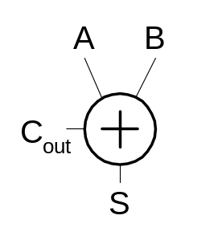
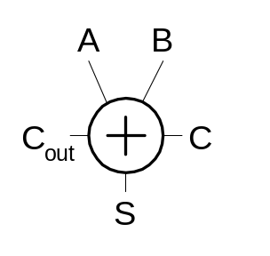
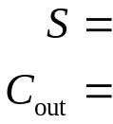

Single-Bit Addition
Half Adder Full Adder
A | B | C | C_{o} | S
0 | 0 | 0
0 | 0 | 1
0 | 1 | 0
0 | 1 | 1
1 | 0 | 0
1 | 0 | 1
1 | 1 | 0
1 | 1 | 1
A | B | C_{o} | S
0 | 0
0 | 1
1 | 0
1 | 1

Slide 19
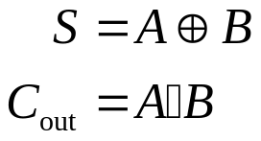
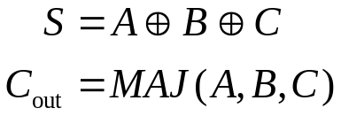
Single-Bit Addition
Half Adder Full Adder
A | B | C_{o} | S
0 | 0 | 0 | 0
0 | 1 | 0 | 1
1 | 0 | 0 | 1
1 | 1 | 1 | 0
A | B | C | C_{o} | S
0 | 0 | 0 | 0 | 0
0 | 0 | 1 | 0 | 1
0 | 1 | 0 | 0 | 1
0 | 1 | 1 | 1 | 0
1 | 0 | 0 | 0 | 1
1 | 0 | 1 | 1 | 0
1 | 1 | 0 | 1 | 0
1 | 1 | 1 | 1 | 1

Slide 20
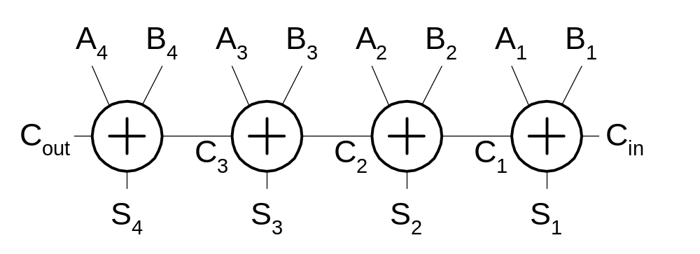
Carry-Ripple Adder
Simplest design: cascade full adders
  Critical path goes from Cin to Cout
  Design full adder to have fast carry delay

Slide 21
Full adder
Computes one-bit sum, carry:
  s_{i} = a_{i} XOR b_{i} XOR c_{i}
  c_{i+1} = a_{i}b_{i} + a_{i}c_{i} + b_{i}c_{i}
Half adder computes two-bit sum.
Ripple-carry adder: n-bit adder built from full adders.
Delay of ripple-carry adder goes through all carry bits.

Slide 22
Verilog for full adder
module fulladd(a,b,carryin,sum,carryout);
input a, b, carryin; /* add these bits*/
output sum, carryout; /* results */
assign {carryout, sum} = a + b + carryin;
/* compute the sum and carry */
endmodule

Slide 23
Verilog for ripple-carry adder
module nbitfulladd(a,b,carryin,sum,carryout)
input [7:0] a, b; /* add these bits */
input carryin; /* carry in*/
output [7:0] sum; /* result */
output carryout;
wire [7:1] carry; /* transfers the carry between bits */
fulladd a0(a[0],b[0],carryin,sum[0],carry[1]);
fulladd a1(a[1],b[1],carry[1],sum[1],carry[2]);
…
fulladd a7(a[7],b[7],carry[7],sum[7],carryout]);
endmodule

Slide 24
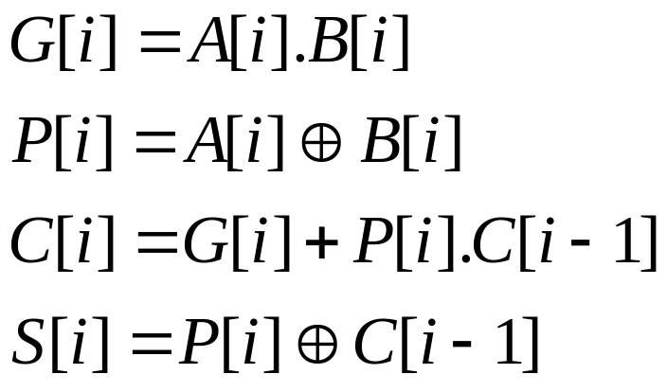
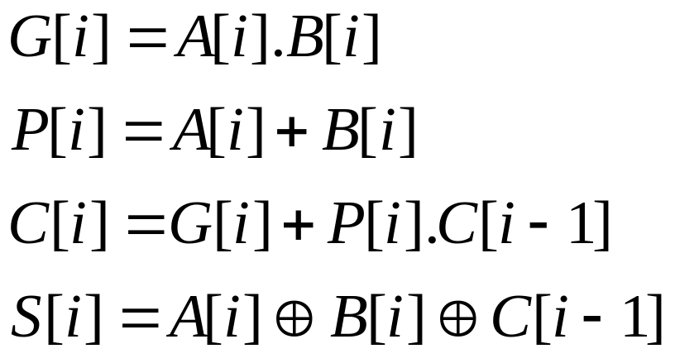
Generate and Propagate
Two methods to develop C[i] and S[i].

Slide 25
Both are correct
Because, A[i]=1 and B[i]=1 (which may lead to a difference is taken care of by the term A[i]B[i])
How do we make an n bit adder?
The delay of the adder chain needs to be optimized.

Slide 26
Carry-lookahead adder
First compute carry propagate, generate:
  P_{i} = a_{i} + b_{i}
  G_{i} = a_{i} b_{i}
Compute sum and carry from P and G:
  s_{i} = c_{i} XOR P_{i} XOR G_{i}
  c_{i+1} = G_{i} + P_{i}c_{i}

Slide 27
Carry-lookahead expansion
Can recursively expand carry formula:
  c_{i+1} = G_{i} + P_{i}(G_{i-1} + P_{i-1}c_{i-1})
  c_{i+1} = G_{i} + P_{i}G_{i-1} + P_{i}P_{i-1} (G_{i-2} + P_{i-1}c_{i-2})
Expanded formula does not depend on intermerdiate carries.
Allows carry for each bit to be computed independently.

Slide 28
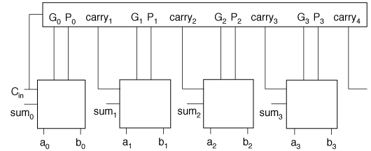
Depth-4 carry-lookahead

Slide 29
Analysis
As we look ahead further logic becomes complicated.
Takes longer to compute
Becomes less regular.
There is no similarity of logic structure in each cell.
We have developed CLA adders, like Brent-Kung adder.

Slide 30
Verilog for carry-lookahead carry block
module carry_block(a,b,carryin,carry);
input [3:0] a, b; /* add these bits*/
input carryin; /* carry into the block */
output [3:0] carry; /* carries for each bit in the block */
wire [3:0] g, p; /* generate and propagate */
assign g[0] = a[0] & b[0]; /* generate 0 */
assign p[0] = a[0] ^ b[0]; /* propagate 0 */
assign g[1] = a[1] & b[1]; /* generate 1 */
assign p[1] = a[1] ^ b[1]; /* propagate 1 */
…
assign carry[0] = g[0] | (p[0] & carryin);
assign carry[1] = g[1] | p[1] & (g[0] | (p[0] & carryin));
assign carry[2] = g[2] | p[2] &
(g[1] | p[1] & (g[0] | (p[0] & carryin)));
assign carry[3] = g[3] | p[3] &
(g[2] | p[2] & (g[1] | p[1] & (g[0] | (p[0] & carryin))));
endmodule
  ci+1 = Gi + Pi(Gi-1 + Pi-1ci-1)

Slide 31
Verilog for carry-lookahead sum unit
module sum(a,b,carryin,result);
input a, b, carryin; /* add these bits*/
output result; /* sum */
assign result = a ^ b ^ carryin;
/* compute the sum */
endmodule

Slide 32
Verilog for carry-lookahead adder
module carry_lookahead_adder(a,b,carryin,sum,carryout);
input [15:0] a, b; /* add these together */
input carryin;
output [15:0] sum; /* result */
output carryout;
wire [16:1] carry; /* intermediate carries */
assign carryout = carry[16]; /* for simplicity */
/* build the carry-lookahead units */
carry_block b0(a[3:0],b[3:0],carryin,carry[4:1]);
carry_block b1(a[7:4],b[7:4],carry[4],carry[8:5]);
carry_block b2(a[11:8],b[11:8],carry[8],carry[12:9]);
carry_block b3(a[15:12],b[15:12],carry[12],carry[16:13]);
/* build the sum */
sum a0(a[0],b[0],carryin,sum[0]);
sum a1(a[1],b[1],carry[1],sum[1]);
…
sum a15(a[15],b[15],carry[15],sum[15]);
endmodule

Slide 33
Dealing with the problem of carry propagation
Reduce the carry propagation time.
To detect the completion of the carry propagation time.
We have seen some ways to do the former. How do we do the second one?

Slide 34
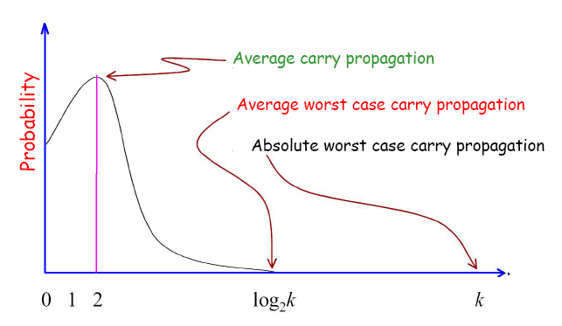
Motivation

Slide 35
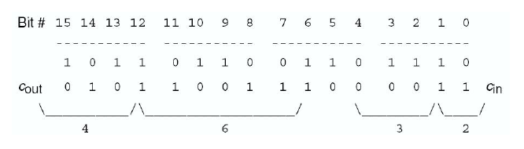
Carry Completion Sensing
A=0 0 1 1 1 0 1 1 0 1 1 0 1 1 0 1
B=0 1 0 0 1 1 1 0 0 0 0 1 0 1 0 1
---------------------------------------------
4
1
5
1

Slide 36
Can we compute the average length of carry chain?
What is the probability that a chain generated at position i terminates at j?
  It terminates if both the inputs A[j] and B[j] are zero or 1.
  From i+1 to j-1 the carry has to propagate.
  p=(1/2)^{j-I}
  So, what is the expected length?
  Define a random variable L, which denotes the length of the chain.

Slide 37
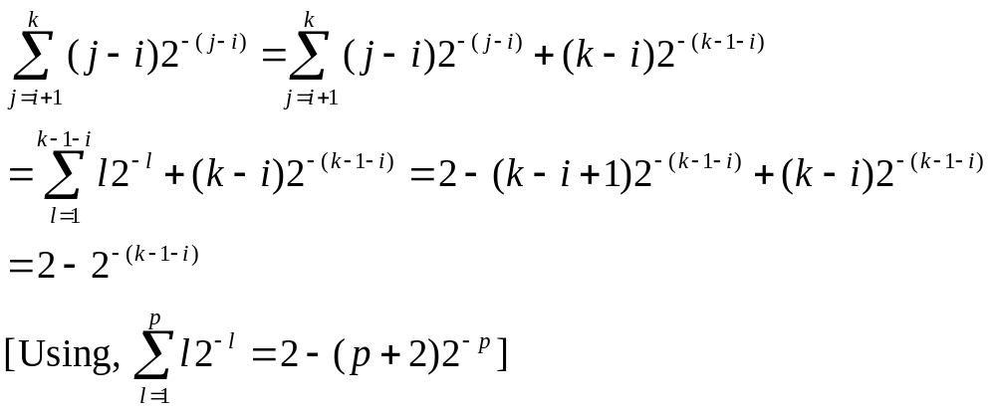
Expected length
The chain can terminate at j=i+1 to j=k (the MSB position of the adder)
Thus L=j-i for a choice of j.
Thus expected length is:
approximately 2!

Slide 38
Carry completion sensing adder
A=011101101101101
B=100111000010101
------------------------------
C=000000000000000
N=000000000000000
------------------------------
C=000101000000101
N=000000010000010
A=011101101101101
B=100111000010101
------------------------------
C=000101000000101
N=000000010000010
------------------------------
C=001111000001101
N=000000110000010

Slide 39
Carry completion sensing adder
A=011101101101101
B=100111000010101
------------------------------
C=001111000001101
N=000000110000010
------------------------------
C=011111000011101
N=000000110000010
A=011101101101101
B=100111000010101
------------------------------
C=011111000011101
N=000000110000010
------------------------------
C=111111000111101
N=000000110000010

Slide 40
Carry completion sensing adder
A=011101101101101
B=100111000010101
------------------------------
C=111111000111101
N=000000110000010 ------------------------------
C=111111001111101
N=000000110000010

Slide 41
Carry completion sensing adder
(A[i],B[i])=(0,0)=>(Ci,Ni)=(0,1)
(A[i],B[i])=(1,1)=>(Ci,Ni)=(1,0)
(A[i],B[i])=(0,1)=>(Ci,Ni)=(Ci-1,Ni-1)
(A[i],B[i])=(0,0)=>(Ci,Ni)=(Ci-1,Ni-1)
Stop, when for all I, Ci V Ni = 1

Slide 42
Justification
Ci and Ni together is a coding for the carry.
When Ci=1, carry can be computed. Make Ni=0
When Ci=0 is the final carry, then indicate by Ni=1
The carry can be surely stated when both Ai and Bi are 1’s or 0’s.

Slide 43
Carry-skip adder
Looks for cases in which carry out of a set of bits is identical to carry in.
Typically organized into b-bit stages.
Can bypass carry through all stages in a group when all propagates are true: P_{i} P_{i+1} … P_{i+b-1}.
  Carry out of group when carry out of last bit in group or carry is bypassed.

Slide 44
Carry-skip structure
c_{i}
AND
P_{i}
P_{i+1}
…
P_{i+b-1}
OR
C_{i+b-1}

Slide 45
Carry-skip structure
b adder stages
b adder stages
b adder stages
Carry out
P[2b,3b-1]
Carry out
P[b,2b-1]
Carry out
P[0,b-1]
skip
skip
skip
Cin

Slide 46
Worst-case carry-skip
Worst-case carry-propagation path goes through first, last stages:

Slide 47
Verilog for carry-skip add with P
module fulladd_p(a,b,carryin,sum,carryout,p);
input a, b, carryin; /* add these bits*/
output sum, carryout, p; /* results including propagate */
assign {carryout, sum} = a + b + carryin;
/* compute the sum and carry */
assign p = a ^ b;
endmodule

Slide 48
Want to use ripple carry adder for the blocks
module fulladd_p(a,b,carryin,sum,carryout,p);
input a, b, carryin; /* add these bits*/
output sum, carryout, p; /* results including propagate */
$rtl_binding=“ADD3_RPL”;
assign {carryout, sum} = a + b + carryin;
/* compute the sum and carry */
assign p = a ^ b;
endmodule
Directive to a synthesis tool!

Slide 49
Verilog for carry-skip adder
module carryskip(a,b,carryin,sum,carryout);
input [7:0] a, b; /* add these bits */
input carryin; /* carry in*/
output [7:0] sum; /* result */
output carryout;
wire [8:1] carry; /* transfers the carry between bits */
wire [7:0] p; /* propagate for each bit */
wire cs4; /* final carry for first group */
fulladd_p a0(a[0],b[0],carryin,sum[0],carry[1],p[0]);
fulladd_p a1(a[1],b[1],carry[1],sum[1],carry[2],p[1]);
fulladd_p a2(a[2],b[2],carry[2],sum[2],carry[3],p[2]);
fulladd_p a3(a[3],b[3],carry[3],sum[3],carry[4],p[3]);
assign cs4 = carry[4] | (p[0] & p[1] & p[2] & p[3] & carryin);
fulladd_p a4(a[4],b[4],cs4, sum[4],carry[5],p[4]);
…
assign carryout = carry[8] | (p[4] & p[5] & p[6] & p[7] & cs4);
endmodule

Slide 50
Delay analysis
Assume that skip delay = 1 bit carry delay.
Delay of k-bit adder with block size b:
  T = (b-1) + 0.5 + (k/b –2) + (b-1)
  block 0 OR gate skips last block
For equal sized blocks, optimal block size is sqrt(k/2).

Slide 51
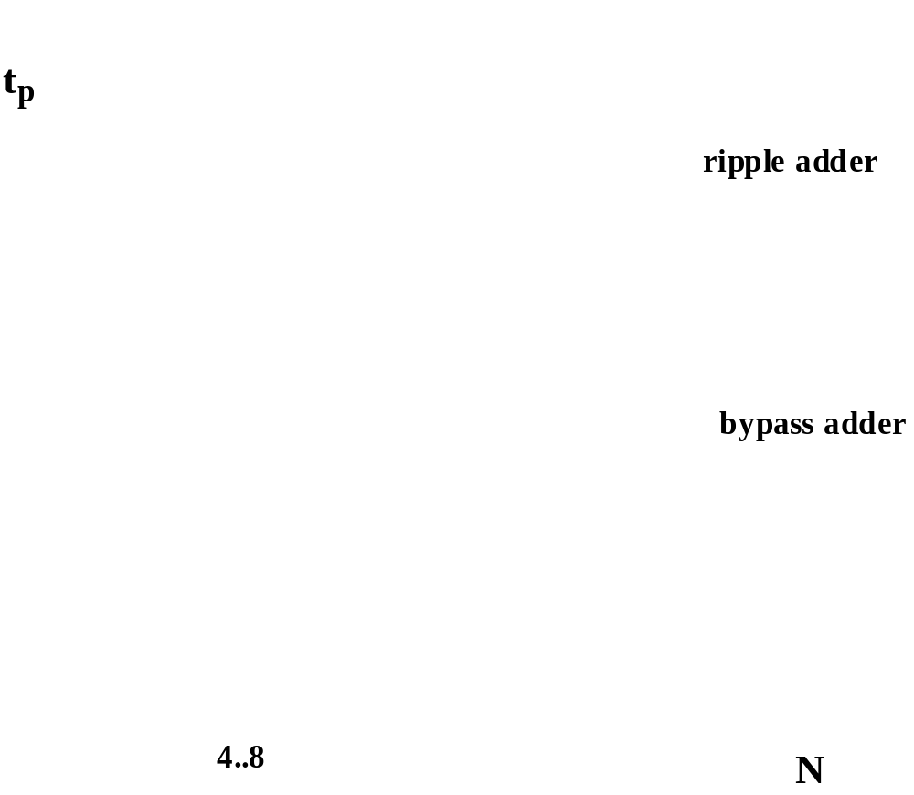
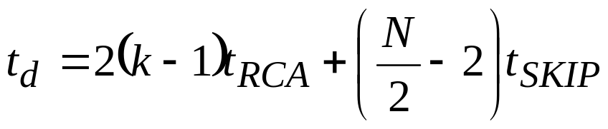
Delay of Carry-Skip Adder
k

Slide 52
Carry-select adder
Computes two results in parallel, each for different carry input assumptions.
Uses actual carry in to select correct result.
Reduces delay to multiplexer.

Slide 53
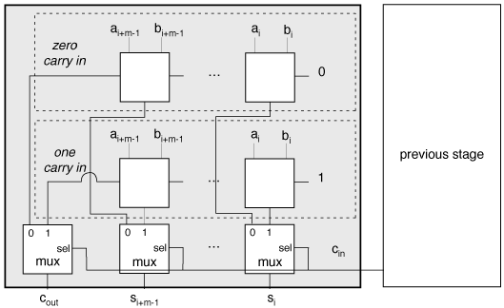
Carry-select structure

Slide 54
Carry-save adder
Useful in multiplication.
Input: 3 n-bit operands.
Output: n-bit partial sum, n-bit carry.
  Use carry propagate adder for final sum.
Operations:
  s = (x + y + z) mod 2.
  c = [(x + y + z) –2] / 2.

Slide 55
Adder comparison
Ripple-carry adder has highest performance/cost.
Optimized adders are most effective in very long bit widths (> 48 bits).

Slide 56
ALUs
ALU computes a variety of logical and arithmetic functions based on opcode.
May offer complete set of functions of two variables or a subset.
ALU built around adder, since carry chain determines delay.

Slide 57
ALU as multiplexer
Compute functions then select desired one:
opcode
AND
OR
NOT
SUM

Slide 58
Implementation of the ALU

